Slide 1
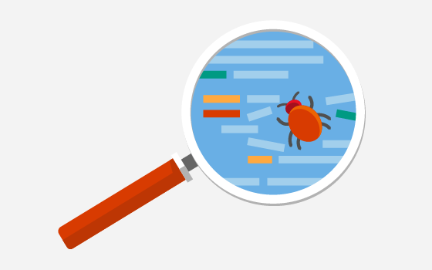
Debug with Chrome DevTools
Notes:
https://www.youtube.com/watch?v=-q1z8BPFItw
Reference https://developer.chrome.com/docs/devtools/overview/

Slide 2
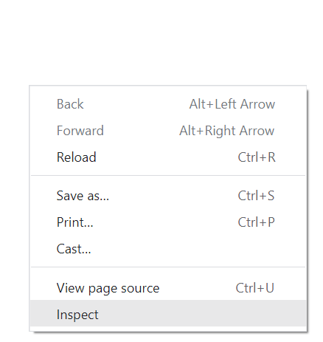
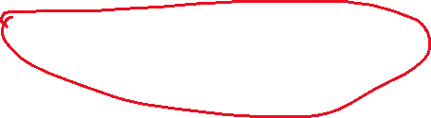
Debug
CSS & HTML
JavaScript
breakpoint
watches
console
call stack
Notes:
Right click -> Inspect to open chrome devtools
Or use shortcut F12 to open chrome devtools

Slide 3
CSS & HTML debugging

Slide 4
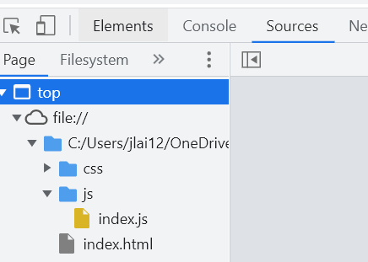
Use sources to check file paths
Check if files are missing.
If so, check the file paths to see if they are correct.
Relative path vs absolute path?
<img src="images/picture.jpg">
<img src=“../images/picture.jpg">
<img src="/images/picture.jpg">
Notes:
<img src="/images/picture.jpg">The "picture.jpg" file is located in the images folder at the root of the current web
<img src="../picture.jpg">The "picture.jpg" file is located in the folder one level up from the current folder
The forward slash make a huge difference

Slide 5
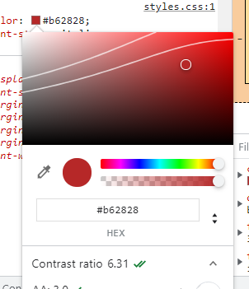
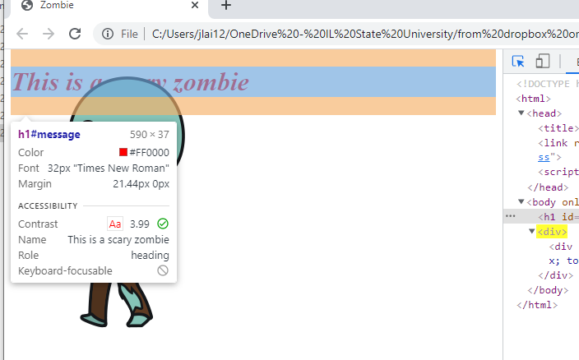

Select an element in the page to inspect it
https://webaim.org/resources/contrastchecker/
Notes:
user agent style sheet is a ”default style sheet” provided by the browser
WCAG-Web Content Accessibility Guidelines (WCAG)--World Wide Web Consortium (W3C)
Elements that are focusable are normally ones that users can interact with, such as links and form controls. There's generally no need to set focus on something if the user can't interact with it.
HSL (for hue, saturation, lightness)
World Wide Web Consortium
Winn Dixie was sued in 2017 for ADA violation

Slide 6
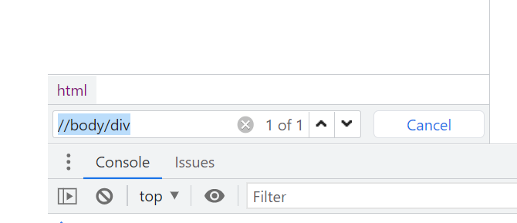
Search element in the page
Ctrl+ F to get the search bar
Then search with keyword, element tag, etc.
Search div in the body section

Slide 7
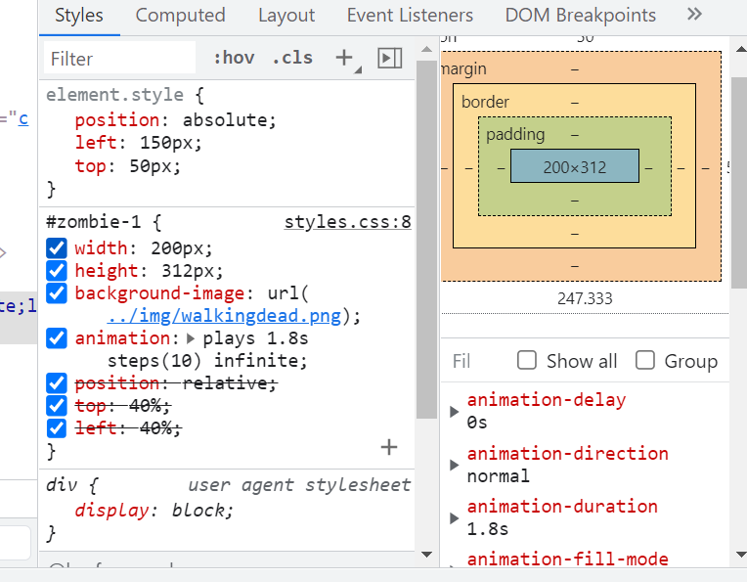
Edit css and html
Notes:
Why some style lines are crossed out?
Uncheck some lines to see the difference
See “styles” and “computed”

Slide 8
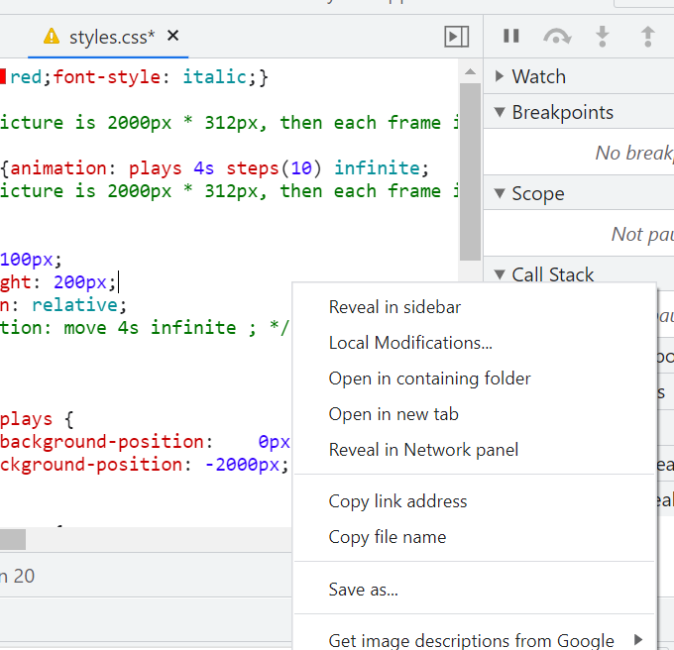
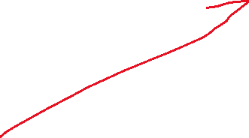
Save changes to css and html
Right click -> Save as
Changes have not been saved

Slide 9
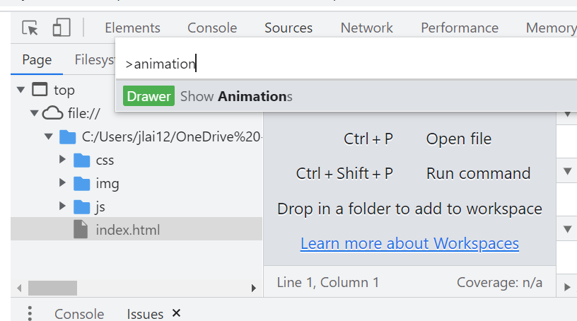
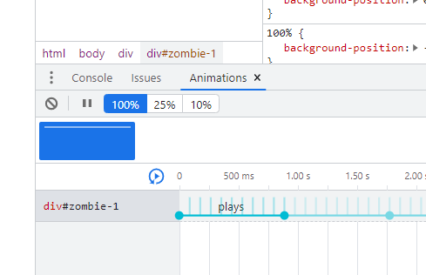
Debug animation
Ctrl+shift+p to run command
Edit animation
Notes:
Check the glowing star animation
Flash--accessibility
Why the third image is not shown in sources? Why no error reported? Because the .star3 class has never be used. If an image is used, but does not exist, there will be an error. Change stars1.png to stars4.png to see if there is an error.
Select the three div to see the difference. star3 css is not used for the third div.
Stars3 to stars4—no error. Means the css section is not used
Need to remove a } to make it work.

Slide 10
JavaScript debugging
Notes:
Shortcut for console panel ctrl +shift +j

Slide 11

Breakpoints
Step
Step over next function
Step into next function
Step out of current function
Notes:
One common strategy is breakpoint
Line-of-code break
Left key does not work
Add breakpoint to line 18 and press up key to see what is step over, step into, step out, and step

Slide 12
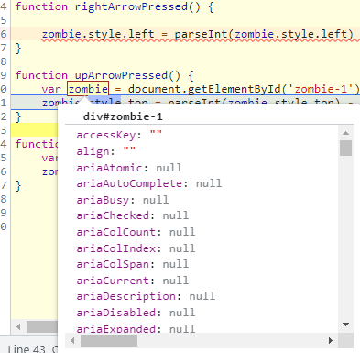
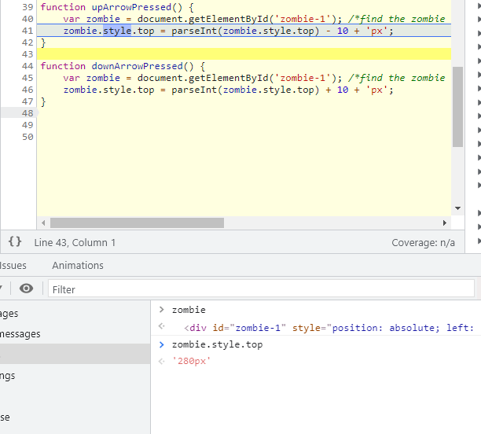
Check variable values
Select the variable with the cursor
Type variable in the console
Notes:
What caused the error in line 35?
Can we make it a global variable?
What is the potential problem of using global variables?
Define zombie = document.getElementById('zombie-1'); /*find the zombie div by ID */ on the top won’t work. Why? When it was initialized, the DOM element is not ready.
How to solve the problem.
Type zombie.style.top to see the value
You can click the eye or just start typing in the console

Slide 13
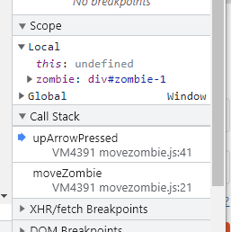
Check variable values with Scope
Notes:
What is local scope?—within current method
Global? Means the browser has access to it. Open Global to see if alert is there? Function moveZombie is there?
Add moveZombie to watch to see if it is global or not
Call stack-the order functions are called-what function is currently being run and what functions are called from within that function
Avoid global variables by wrapping it with an anonymous function---good practice

Slide 14
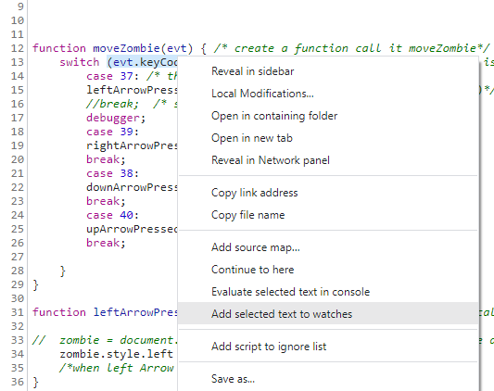
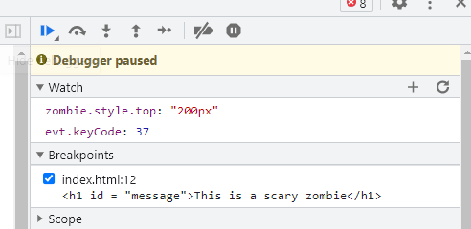


Watch variables
Right click-> Add selected text to watches
Check value in watch

Slide 15
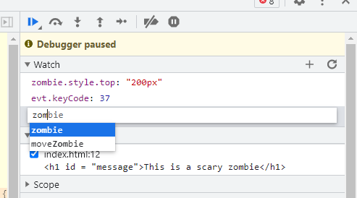

Watch variables
Direct add a variable to watch
Notes:
(function(){})();

Slide 16
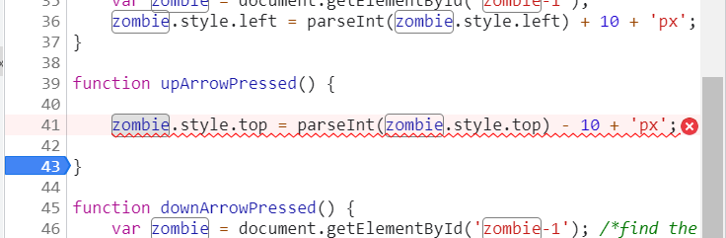
How to make the Up and Down Keys work?
Notes:
Remove var from line 35, will it work? Make sure to click other keys before click the down key to initiate the zombie variable first
Is it good practice.
The rightArrowPressed function should be called to initiate the variable.
If a global and a local both work, which one is preferred?

Slide 17
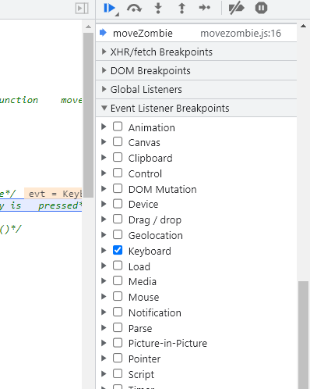
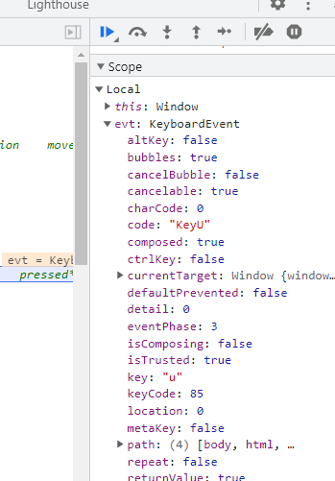
Event Listener Breakpoint

Slide 18
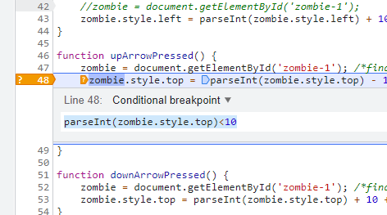
Conditional Breakpoint
Notes:
parseInt(zombie.style.top)<10

Slide 19
DOM Breakpoint
On the code that changes or removes a specific DOM node, or its children.
Types of DOM change breakpoints
Subtree modifications. Triggered when a child of the currently-selected node is removed or added, or the contents of a child are changed. Not triggered on child node attribute changes, or on any changes to the currently-selected node.
Attributes modifications: Triggered when an attribute is added or removed on the currently-selected node, or when an attribute value changes.
Node Removal: Triggered when the currently-selected node is removed.
Notes:
Check the example dombreakpoint

Slide 20
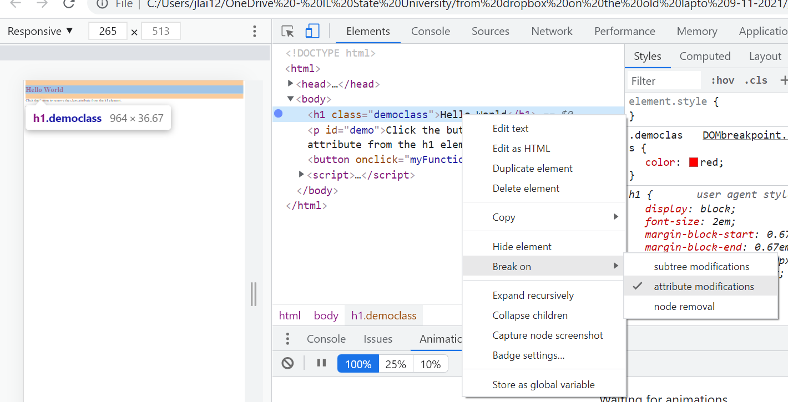




Notes:
Try the DOMbreakpoint demo

Slide 21
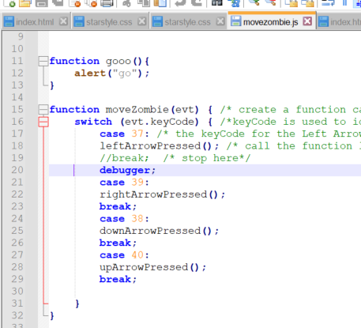
debugger
Add “debugger;” to where you want to pause in your code.
Notes:
Call debugger from your code to pause on that line. This is equivalent to a line-of-code breakpoint, except that the breakpoint is set in your code, not in the DevTools UI.
https://developer.chrome.com/docs/devtools/javascript/breakpoints/
Other things
Global Listeners
XHR/fetch Breakpoints
CSP violation breakpoint
Global Listeners: the active event listeners on the page.
Within Chrome, it's possible to place a breakpoint on a XmlHttpRequest allowing you to debug AJAX requests.
https://developer.chrome.com/blog/new-in-devtools-89/
Content Security Policy (CSP) is a computer security standard introduced to prevent cross-site scripting (XSS), clickjacking and other code injection attacks resulting from execution of malicious content in the trusted web page context.

Slide 22
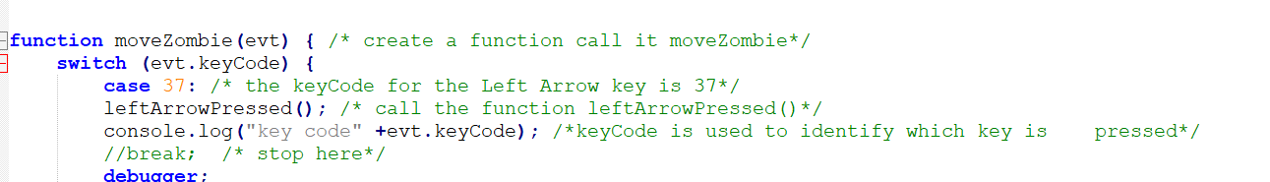
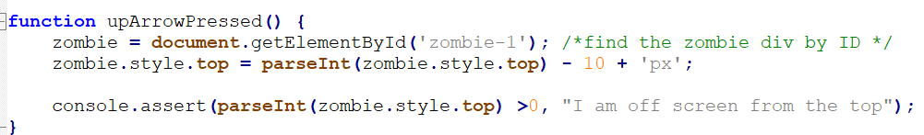

console.log();
console.log ();
console.assert(condition, );
Notes:
console.log("key code" +evt.keyCode); /*keyCode is used to identify which key is pressed*/
console.assert(parseInt(zombie.style.top) >0, "I am off screen from the top");
Similar to java system.out.println();
Console.log printed messages are user message

Slide 23
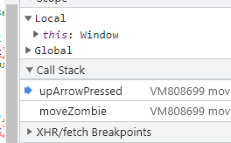
Call Stack
Notes:
what function is currently being run and what functions are called from within that function, etc.
The top line is executed last and it is the current routine.

Slide 24
A quick summary
Debug HTML+CSS with sources and element
Use sources to check file paths
Editing with Element-Do not forget to save the changes to your local file
Breakpoint
Line-of-code breakpoint
Conditional breakpoint
Event Listener breakpoint
DOM breakpoint
debugger;
Check variables
put cursor on the variable
console
scope
watch
Console.log
Call stack

Slide 25
Question: how to let the zombie face right when the right key is clicked?
Notes:
zombie.style.transform = ("scaleX(-1)");

Slide 26
Let’s do some practice

Slide 27
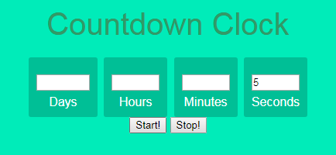
bug 1: only define the number for second does not work

Slide 28
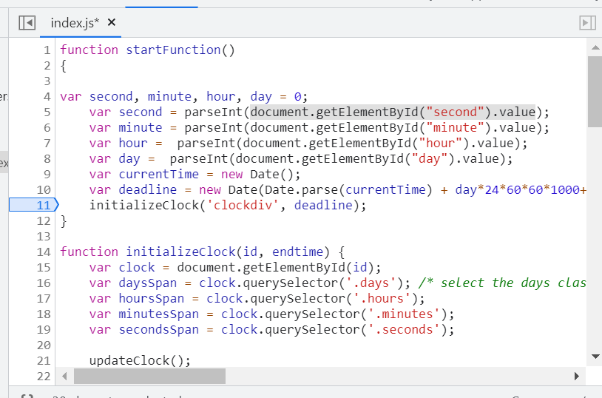
Add breakpoints

Slide 29
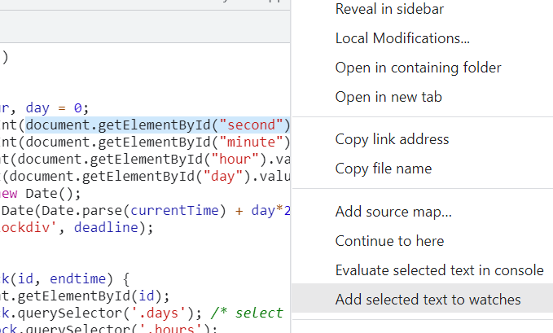
Watch variables

Slide 30
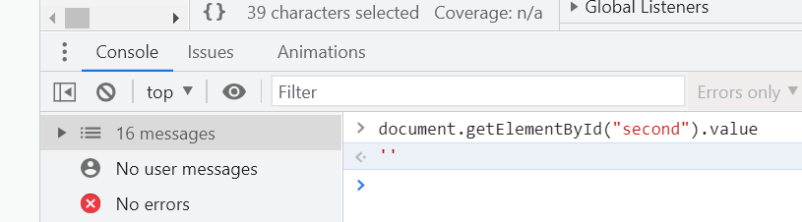
Or use console to see the value
Notes:
var second=0, minute=0, hour=0, day = 0;
if (document.getElementById("second").value !=""){
second = parseInt(document.getElementById("second").value);
}
if(document.getElementById("minute").value !=""){
minute = parseInt(document.getElementById("minute").value);
}
if (document.getElementById("hour").value != ""){
hour = parseInt(document.getElementById("hour").value);
}
if (document.getElementById("day").value != ""){
day = parseInt(document.getElementById("day").value);
}

Slide 31
How to fix the problem?
var second = 0, minute = 0, hour = 0, day = 0;
if (document.getElementById("second").value !== "")
second = parseInt(document.getElementById("second").value);
Notes:
var second=0, minute=0, hour=0, day = 0;
if (document.getElementById("second").value !=""){
second = parseInt(document.getElementById("second").value);
}
if(document.getElementById("minute").value !=""){
minute = parseInt(document.getElementById("minute").value);
}
if (document.getElementById("hour").value != ""){
hour = parseInt(document.getElementById("hour").value);
}
if (document.getElementById("day").value != ""){
day = parseInt(document.getElementById("day").value);
}

Slide 32
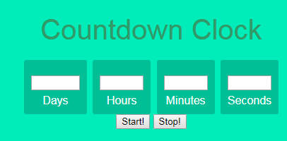
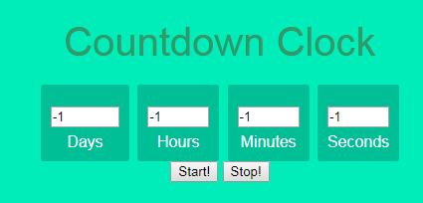
bug 2: starting with 0s

Slide 33
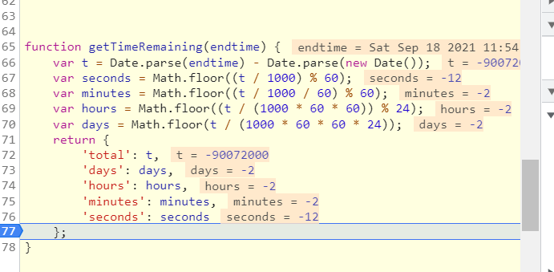
Why t < 0?

Slide 34
How to solve the problem?
Notes:
var seconds = 0, minutes=0, hours=0, days = 0;
if (t>0){
seconds= Math.floor((t / 1000) % 60);
minutes= Math.floor((t / 1000 / 60) % 60);
hours= Math.floor((t / (1000 * 60 * 60)) % 24);
days= Math.floor(t / (1000 * 60 * 60 * 24));
}

Slide 35
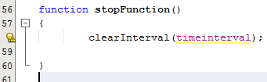
bug 3: stop button does not work

Slide 36
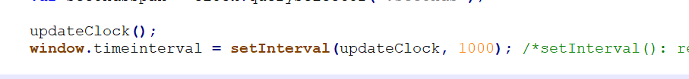
One way to make a global variable
Notes:
clearInterval(window.timeinterval);

Slide 37
Reminder
Read jQuery tutorial
https://www.w3schools.com/jquERy/default.asp
Assignment 2 is due on Wednesday

